Slide 1

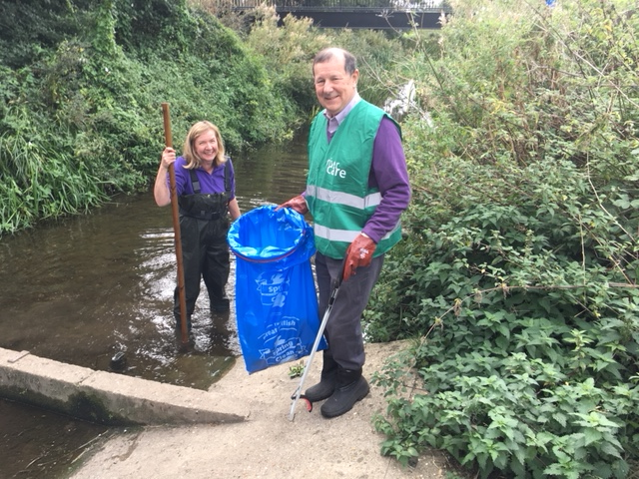

Recruitment Pack
Senior Community Environment Officer

Slide 2

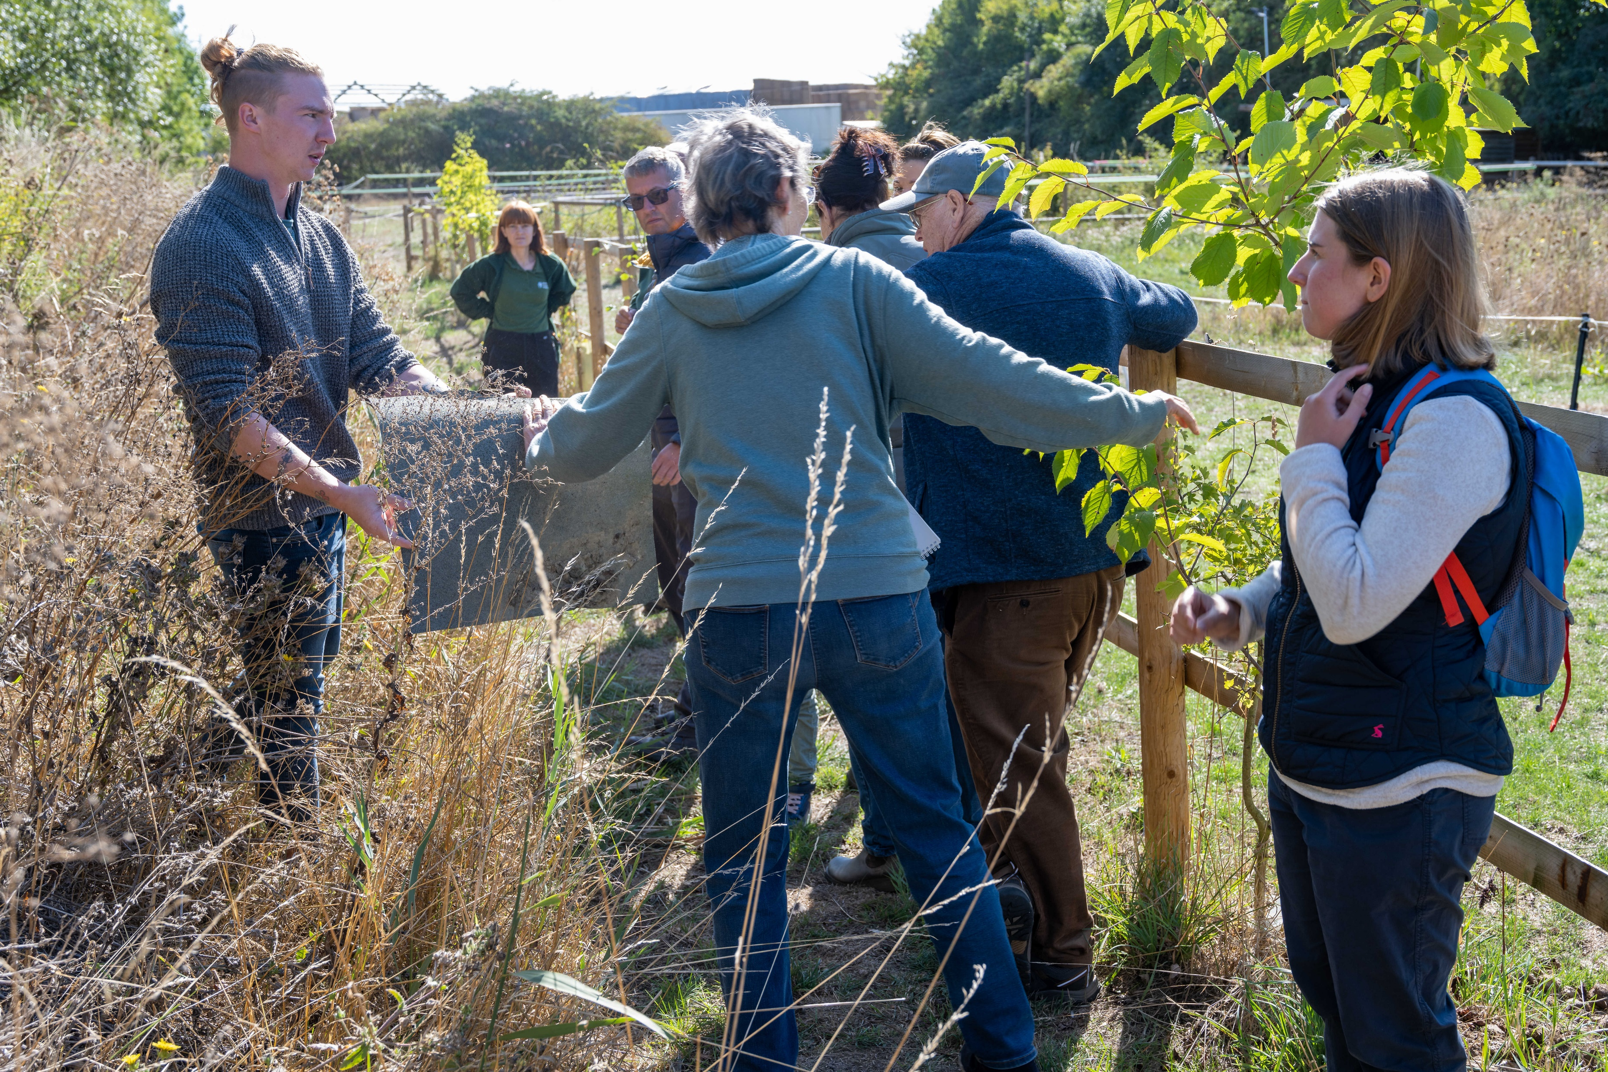
Who we are and what we do
Established in 1924, Cambridgeshire ACRE is a charity that works alongside the rural communities of Cambridgeshire and Peterborough. We help them take action to make positive changes to their local neighbourhoods.
Whether it’s supporting volunteers to lead community projects, bringing local organisations together to drive meaningful change or amplifying the voices of our parish and community members, our charity is deeply embedded in rural community life.
With our support, residents, groups and partners can seize opportunities and realise their aspirations to improve the places, services, facilities and natural environments that are important to them.
Our mission
To inspire, lead and partner with rural communities, enabling local people to create positive, lasting change for themselves.
Our vision
Rural communities across Cambridgeshire and Peterborough where people flourish, connections grow and everyone can thrive.
Our purpose
We exist to empower rural communities. By offering specialist support, facilitating collaboration and championing local voices, we help communities tackle challenges confidently, sustainably and creatively.
Volunteers on a guided walk
Residents attending a Community Health & Wellbeing Hub

Slide 3
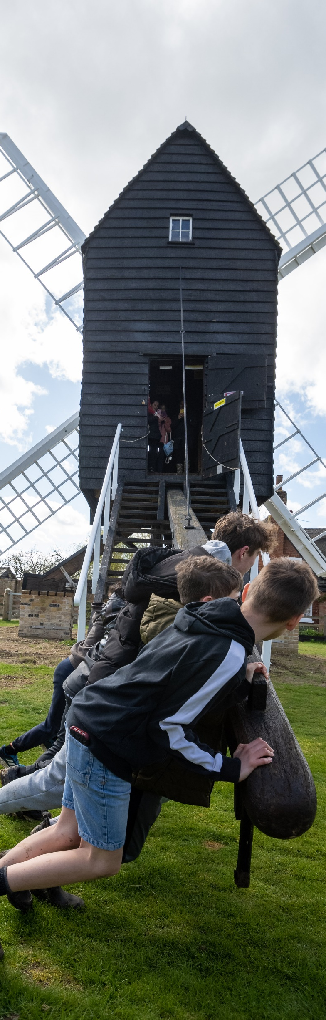
Young people taking part in one of our heritage projects
Our values
1. Empowerment
We believe rural communities hold the answers to their own success. Our role is to provide the tools, support and encouragement that enable local people to lead and act.
2. Collaboration
We achieve more together. Through genuine partnerships built on trust and understanding, we work alongside communities and stakeholders, pooling expertise and resources.
3. Integrity
Honesty, openness and accountability are non-negotiable. Communities trust us because we always act independently and ethically, placing their needs above all else.
4. Creativity
Innovation drives us forward. We proactively seek imaginative, effective solutions that address rural challenges sustainably and uniquely.
5. Commitment
Our dedication to rural communities runs deep. We remain proactive, reliable and driven, tirelessly advocating and working for a sustainable, inclusive future for rural Cambridgeshire and Peterborough.

Slide 4
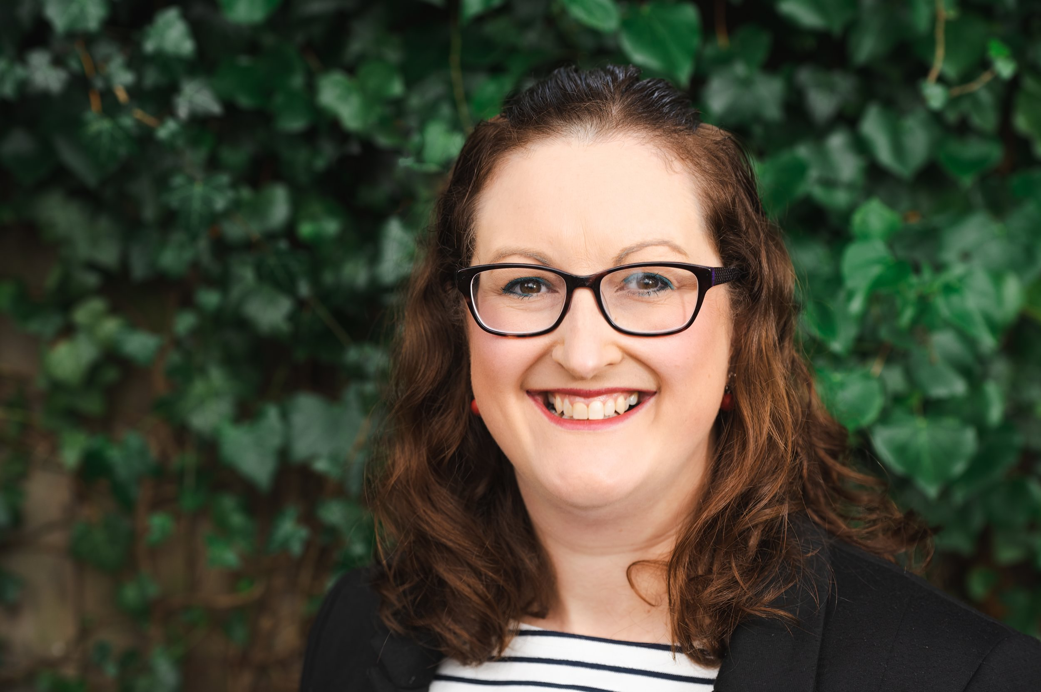
Message from our
Chief Executive
Thank you for your interest in the role of Senior Community Environment Officer at Cambridgeshire ACRE.
Our rural communities care deeply about the places where they live. Across Cambridgeshire, volunteers, parish councils and community groups are taking action to improve local environments, protect biodiversity, care for watercourses and create greener, more resilient communities. This role offers an exciting opportunity to help turn that passion into practical action.
As an independent rural community development charity, Cambridgeshire ACRE brings people together, develops partnerships and supports communities to lead positive change. We know that environmental improvements are most successful when they are shaped and delivered by local people. Whether that means supporting volunteers, developing community projects or helping partners work together effectively, this role will be at the heart of that work.
This is a fantastic opportunity for someone who enjoys working with people as much as they enjoy working outdoors. You will help communities take action, support volunteers, build relationships and deliver projects that make a visible difference to local environments.
At Cambridgeshire ACRE, our staff are critical in making this happen. We are a friendly and supportive team that values your experience, skills and ideas. In return, we provide comprehensive induction, training and the flexibility needed to maintain a healthy work-life balance.
I hope you will explore this information pack further and consider joining us. If you share our passion for supporting communities and creating positive environmental change, we would be delighted to hear from you.
Hayley
Cambridgeshire ACRE’s Chief Executive, Hayley Neal

Slide 5

The role at a glance
Hours
31.5 per week
Salary
SCP 23 on the NJC payscale (currently £34,434 per annum for a 35 hour week, giving a pro rata salary of £30,990)
Location
Home based with frequent travel across Cambridgeshire and Peterborough
Contract length
Fixed term until 31-Mar-2027. Subject to future funding, there may be opportunities to continue with Cambridgeshire ACRE beyond the initial contract period.
Start date
As soon as possible
Holiday
25 days per year plus bank holidays (pro rata)
Reports to
Chief Executive
Other workplace benefits
Working from home allowance
Flexible working
Workplace pension scheme including an option for salary sacrifice
Support and encouragement with personal development

Slide 6
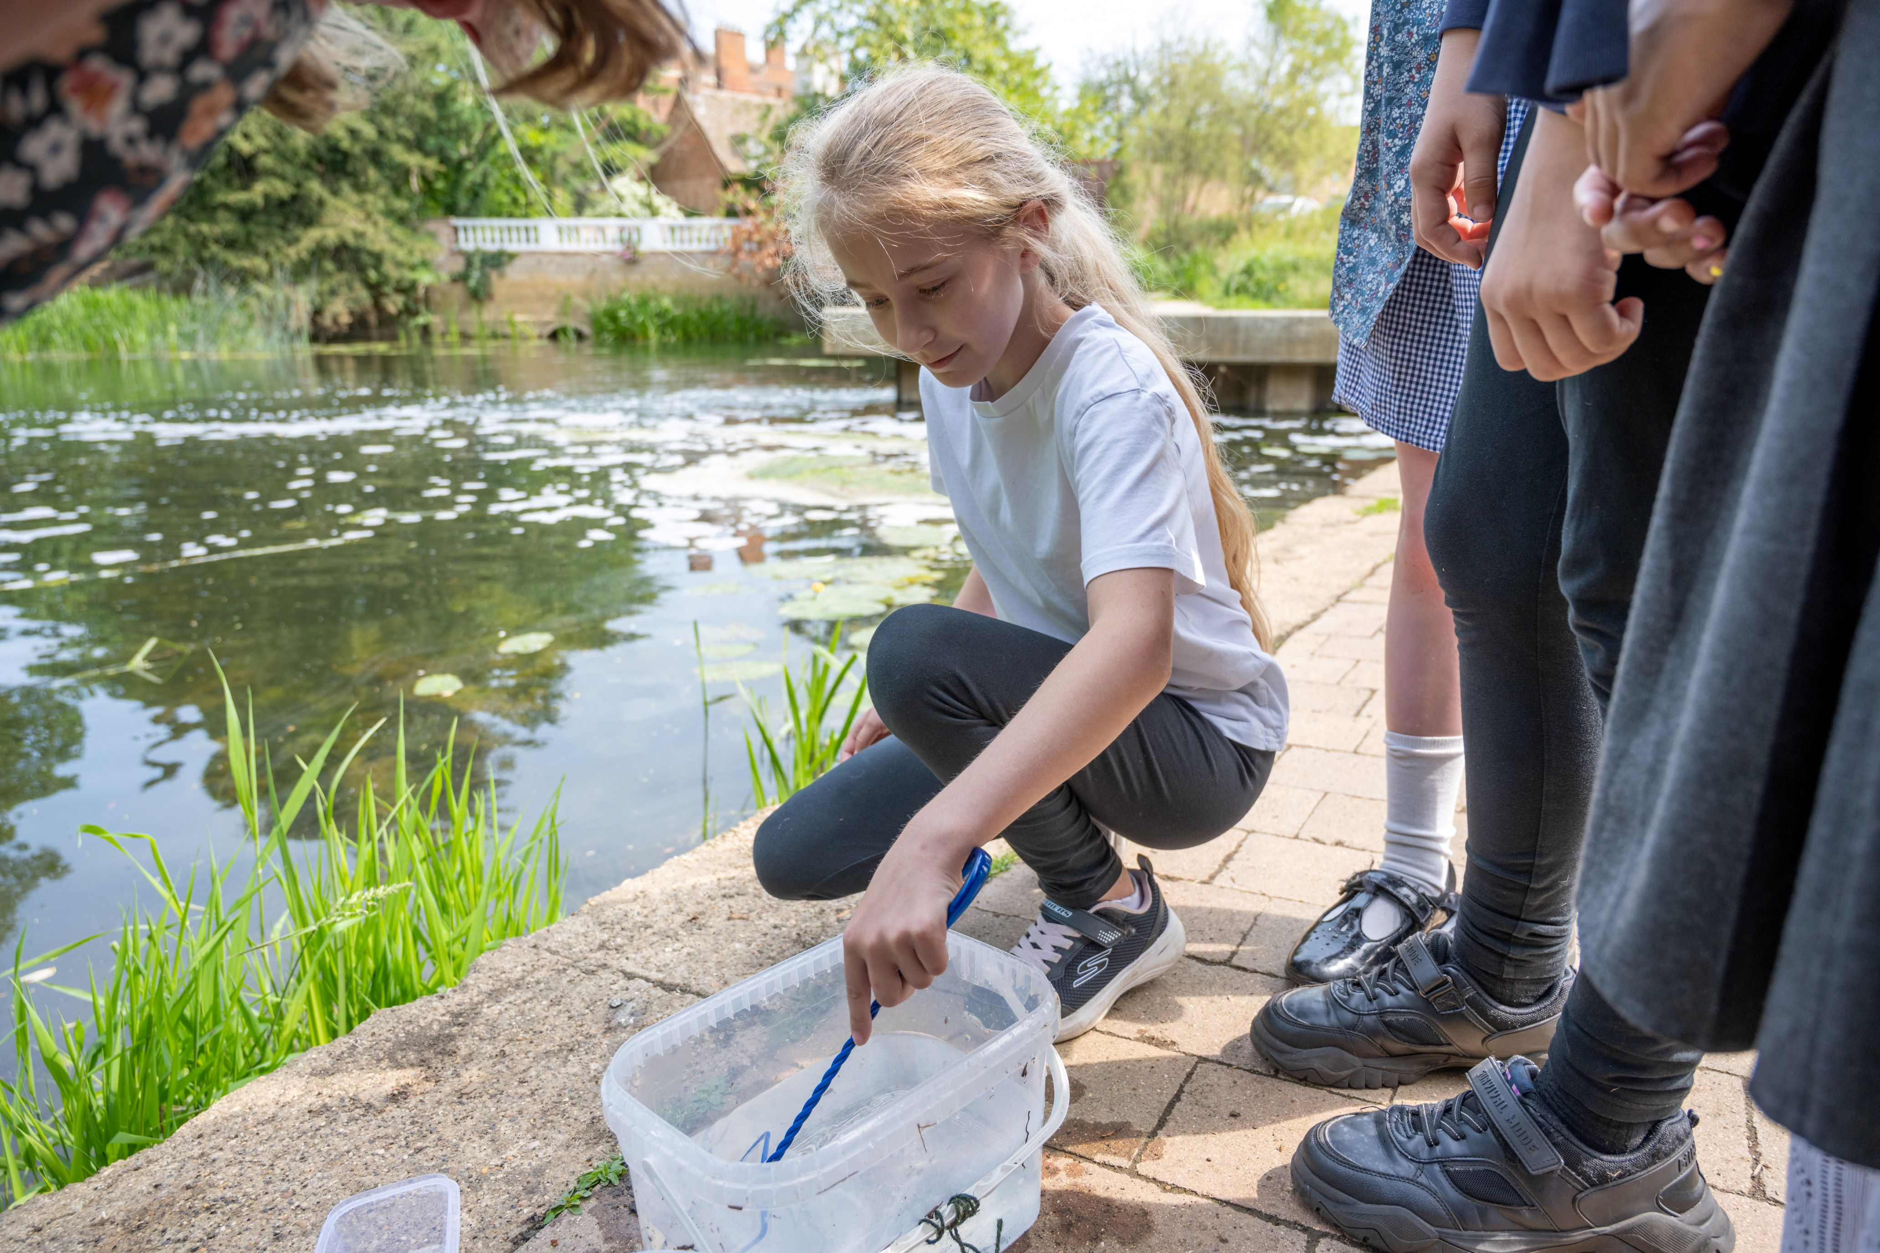
Job purpose and main tasks
Releasing young eels into the River Ouse through our Eels in the Classroom project
We are seeking an enthusiastic and motivated Senior Community Environment Officer to help communities take action for nature, water and the environment.
Working with volunteers, parish councils, community groups and partner organisations, you will support the delivery of environmental projects that improve local places, strengthen community involvement and encourage long-term stewardship of natural spaces.
This role combines community development with practical environmental action. You will organise volunteering activities, support local environmental initiatives, build partnerships and help deliver projects that create lasting benefits for both people and nature.
Cambridgeshire ACRE’s Chief Executive, Kirsten Bennett

Slide 7
Job purpose and main tasks
Continued…
Overall purpose of the job
To work with communities, volunteers, parish councils, schools and partner organisations to deliver Cambridgeshire ACRE's environmental programmes.
The postholder will support practical environmental improvements, develop volunteering opportunities, engage communities in local environmental action and help deliver projects that improve water environments, biodiversity and community wellbeing across Cambridgeshire.
Main tasks
Deliver environmental programmes and projects as assigned, including developing project plans and maintaining robust systems for monitoring and evaluation in line with organisational standards.
Develop and manage partnerships with communities, parish councils, schools, statutory agencies and other stakeholders to support the delivery of Cambridgeshire ACRE's environmental work.
Recruit, manage and develop volunteers so they can contribute effectively to environmental projects and community action.
Work with community groups and volunteers, offering facilitation expertise, information, advice and guidance to enable them to undertake environmental improvement projects and activities.
Organise and deliver community engagement activities, volunteering opportunities, training events and practical environmental projects.
Prepare and help others prepare communications and support materials including case studies, guidance documents, newsletters, online resources and promotional materials.
Contribute to the development, delivery and evaluation of projects relating to environmental improvement, biodiversity, water environments and community stewardship.
Gather and analyse information on environmental issues affecting communities and contribute to the development of practical responses and solutions.
Contribute locally and nationally to the development of policies and practices affecting communities and the environment through participation in relevant networks and partnerships.

Slide 8
Qualifications, knowledge & experience, and skills & personal qualities needed
Please download the full job description and person specification to read the complete list of qualifications, knowledge & experience, and skills & personal qualities we are looking for in the person who takes on this role. The following provides a high-level summary:
Qualifications we expect you to hold
Level 6 qualifications including degree with honours or ordinary degree without honours, Level 6 NVQ, Level 6 Diploma or Certificate, Degree Apprenticeship or equivalent experience in community development, environmental management, conservation, geography, sustainability or a related field.
Knowledge and experience we expect you to be able to demonstrate
Experience of delivering community-based projects.
Experience of giving advice to communities and volunteers.
Experience of organising events, training or engagement activities.
Experience of working with community groups and volunteers.
Experience of partnership working and networking.
Knowledge of environmental, conservation, biodiversity or water-related issues.
Experience of delivering environmental, conservation or sustainability projects.
Ability to build positive relationships with a wide range of stakeholders.
Skills and personal qualities you will display
Excellent written and verbal skills.
Excellent communication skills with an ability to use tact, diplomacy and a high degree of relationship management.
Ability to relate to all levels of the organisation confidently and effectively.
Ability to analyse and interpret complex data.
Ability to produce written reports summarising activities and outcomes.
Ability to manage own time and prioritise workload.
Excellent interpersonal skills and the ability to contribute within team environments.
Proficient user of Microsoft Office suite of software.
Flexible approach with a willingness to work outside normal hours on occasions (e.g. evenings and weekends).
Ability to travel independently including use of own car insured for business use.

Slide 9
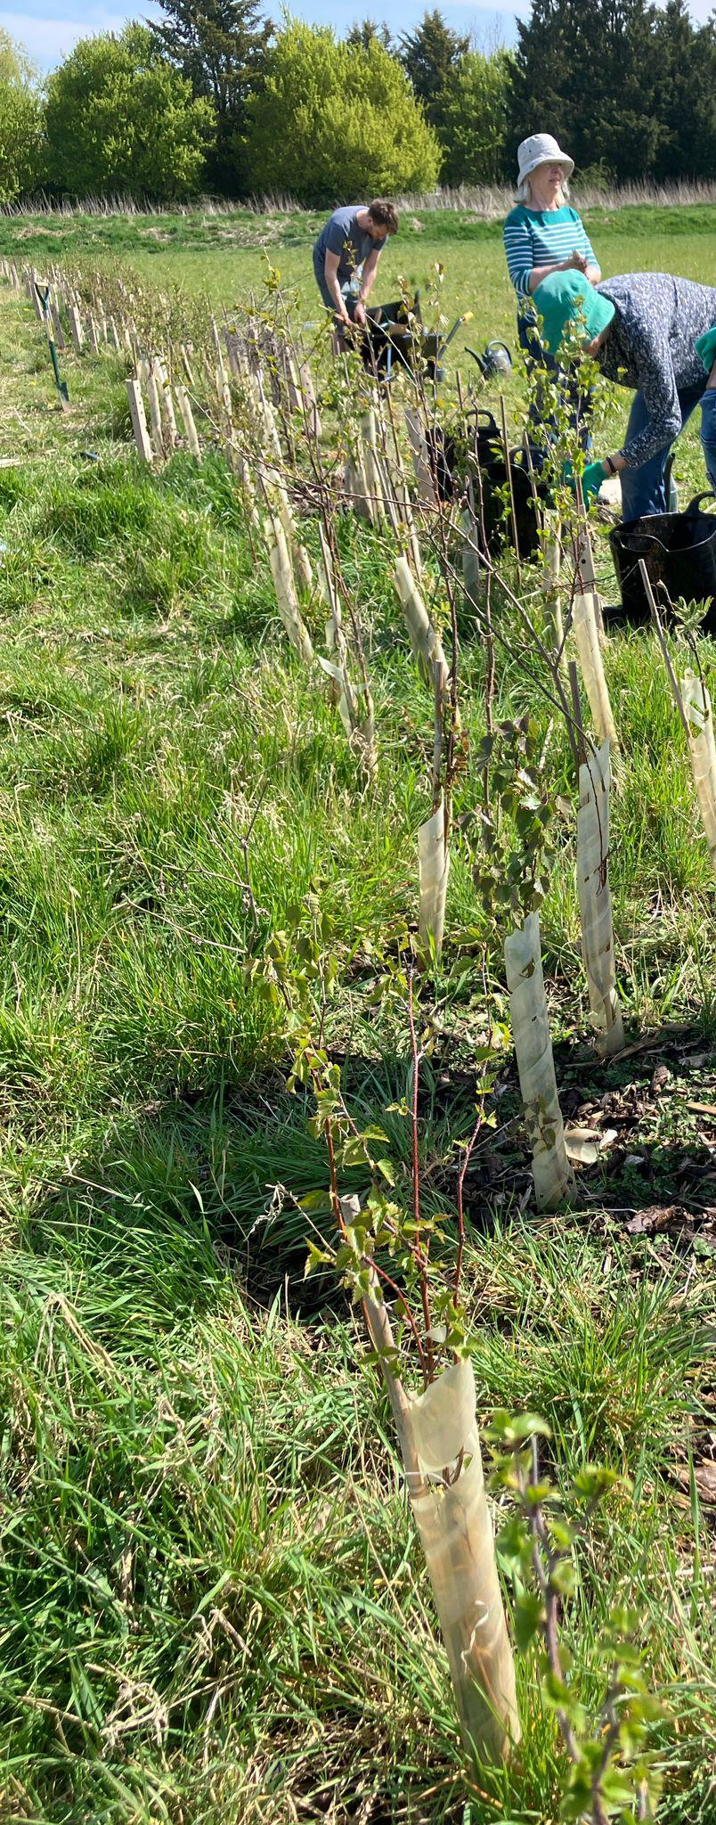
How to apply
Thank you for your interest in this role and joining Cambridgeshire ACRE. We are an equal opportunities employer and welcome applications from every part of the community.
If you would like to talk to someone about this role before you apply, please contact Hayley Neal, Chief Executive via Hayley.neal@cambsacre.org.uk
To apply, please submit a CV and supporting statement (ideally maximum 2 sides of A4 each) that clearly outlines your suitability for the role against the criteria provided in the person specification, including your interest and motivation in applying for this position.
Please ensure that your application is emailed to Hayley.neal@cambsacre.org.uk inserting “Cambridgeshire ACRE – Senior Community Environment Officer” into the subject field.
Use of AI
We understand the value of AI tools and especially recognise their benefit for people who may need help with their writing. However, we have had to reject a number of applications for roles where AI was used to write CVs and supporting statements that were completely unsuitable and too generic to understand. Please use your own words, experience and ideas to give us the best chance of understanding your application.
Volunteers hedge planting

Slide 10
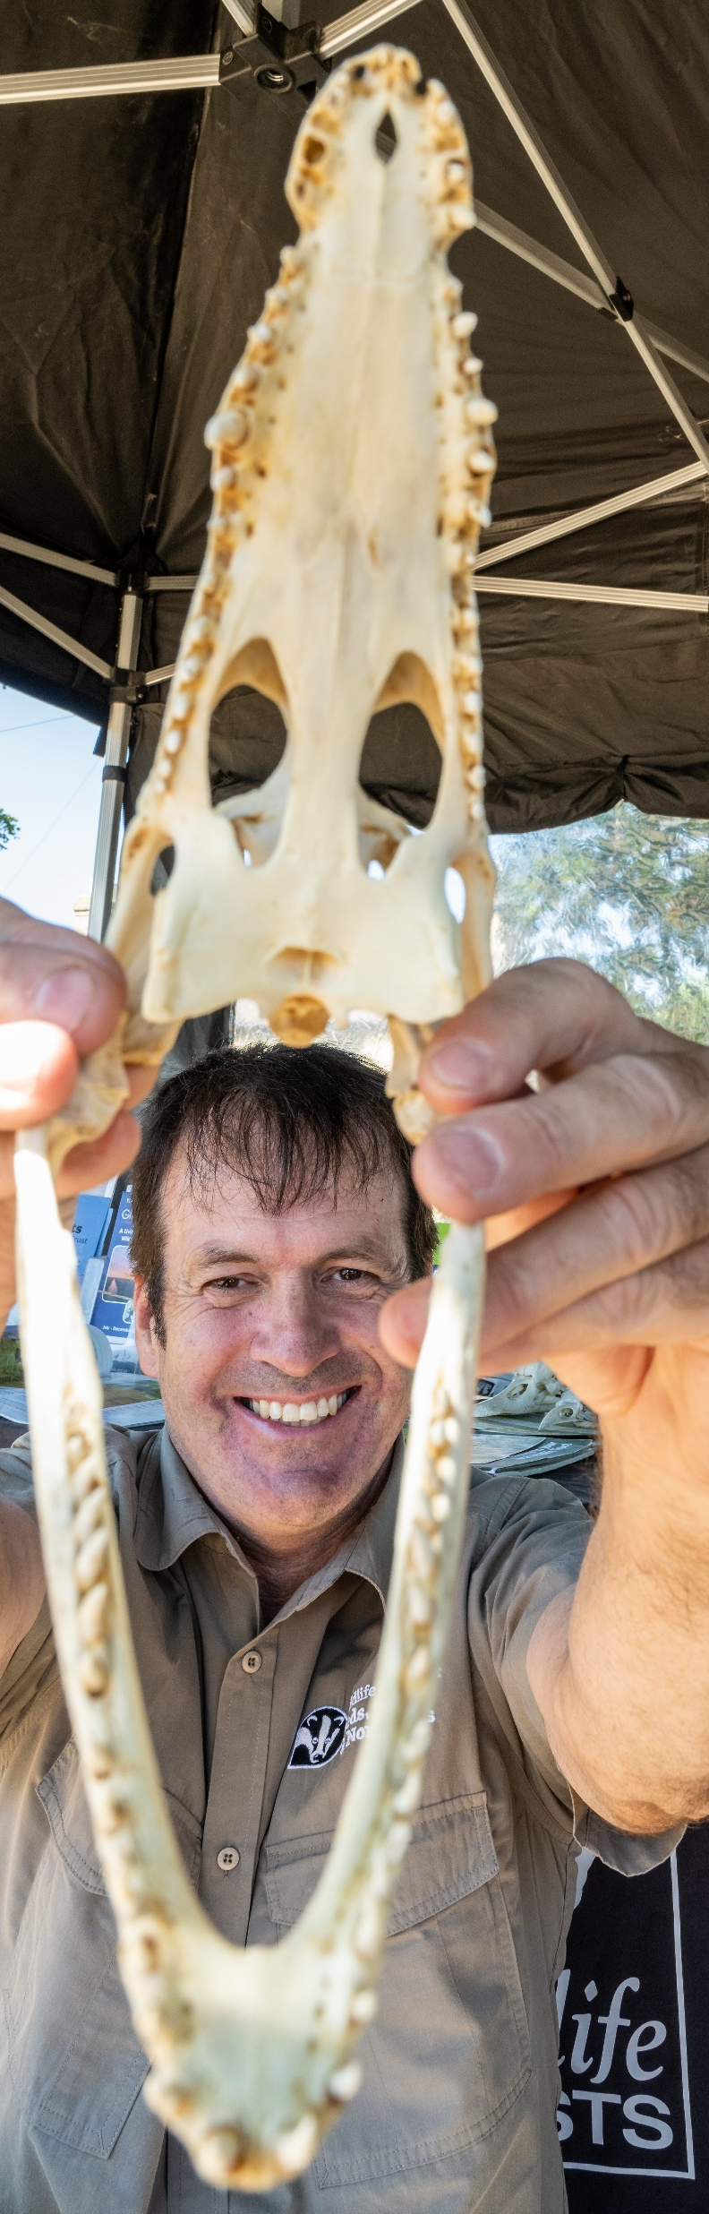
Selection process
A volunteer at one of our many Community Hubs
The closing date for receipt of applications for this role is 8am on 23 June 2026.
All applications received by this deadline will be shortlisted by a panel against the criteria set for the role.
Applicants who are successful in reaching the shortlist will be invited to interview on 7 July 2026. Please note that our normal practice is now to share interview questions in advance of interview with successful candidates.
We ask that you hold this date in your diary until you are informed of the outcome of your application.
Equal Opportunities Monitoring
Cambridgeshire ACRE is committed to promoting equality and diversity. To help us raise awareness and support a culture that is diverse and recognises and develops the potential of all, we need to appreciate the profile of candidates who apply for positions. We will send you an equality monitoring survey at the point of receiving your application. This ensures that our recruitment process is inclusive and equitable and provides us with important data to help us showcase our impact.
The information you provide will be treated confidentially and anonymously and will help us to support our commitment to fair recruitment practice. All information provided will be held in the strictest confidence and will not be shared with anyone, in line with the Data Protection Act 2018. The information provided does not form part of the decision-making process and will not affect your application.
One of our partners attending a NLOW project event

Slide 11
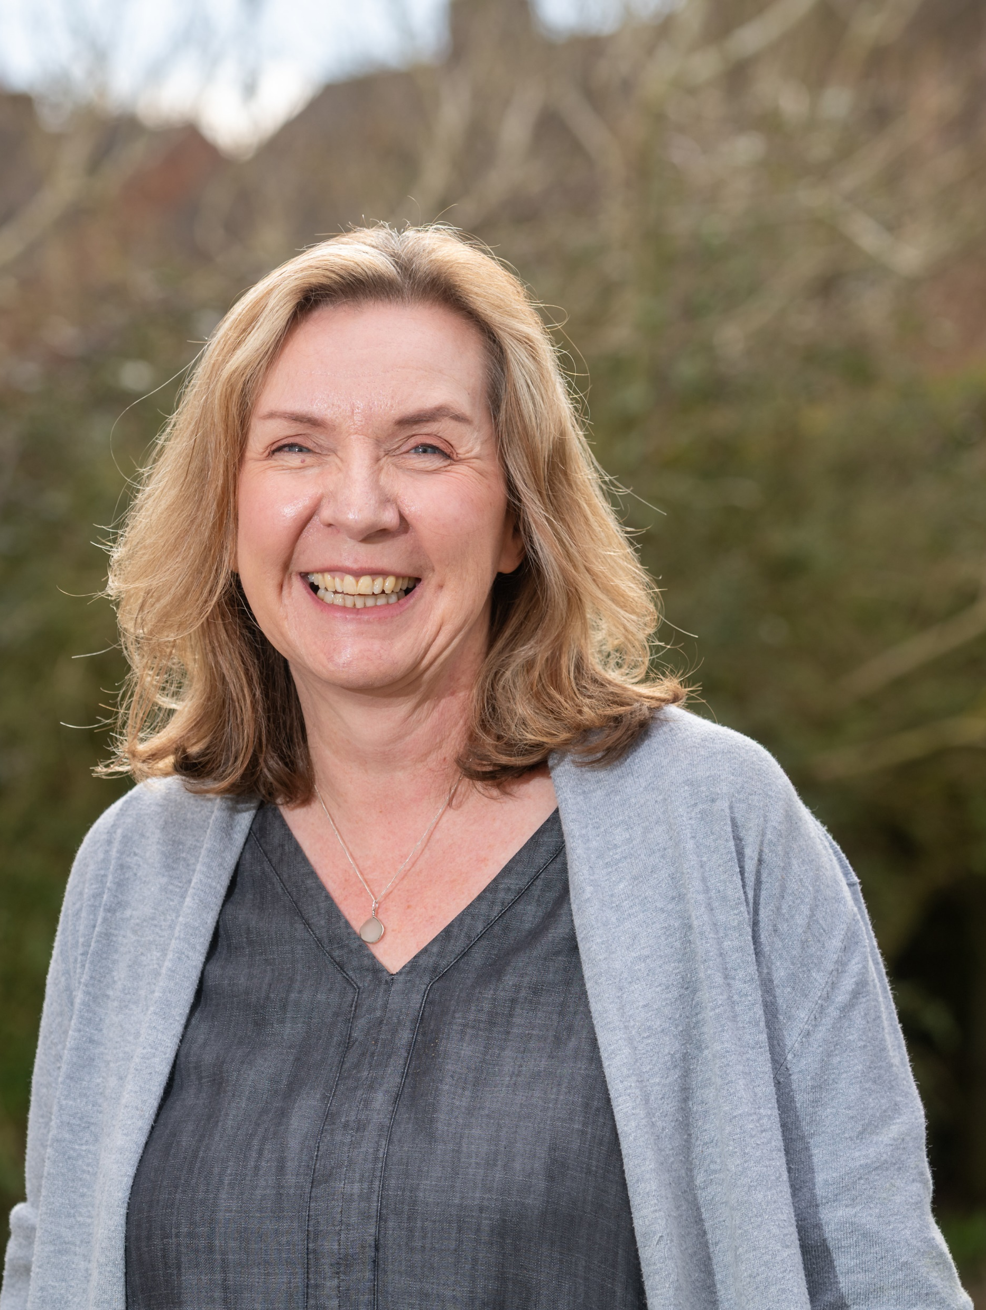
Hear from our staff
Don’t just take our word for it. Here, Rachael, our Senior Community Development Officer, explains why you should consider working for Cambridgeshire ACRE.
What attracted you to apply for a job at Cambridgeshire ACRE?
  The job I applied for combined two of my skills - gardening and teaching. Cambridgeshire ACRE supported me to get back into the world of work after taking 10 years out to raise a family.
What are the aspect of your job that you enjoy most?
  I get huge enjoyment out of working with people. It is great being able to give somebody the information and support they need to enable them to achieve something in their community. I love working with volunteers – I am always amazed at their generosity of spirit, and they make me laugh in so many ways. There are great people out there and this job helps you to connect with them. I feel I am trusted to manage the development and delivery of work programmes and like finding interesting and creative ways to solve the challenges this presents.
What opportunities have there been for you to develop your skills and experience whilst working for the organisation?
  Cambridgeshire ACRE gives me such a wide variety of work that my knowledge, skills and experience are constantly growing.
I am supported to develop missing skills and identify training needs. I have received a wide range of training including community development theory, film making, volunteer management and use of social media. Staff are always happy to share their skills and experience. It is a friendly place to work.
Why would you recommend that people apply for a job at Cambridgeshire ACRE?
Working at Cambridgeshire ACRE will give you a rewarding job; friendly & supportive colleagues and a flexible working life.
Cambridgeshire ACRE Senior Community Development Officer, Rachael

Slide 12
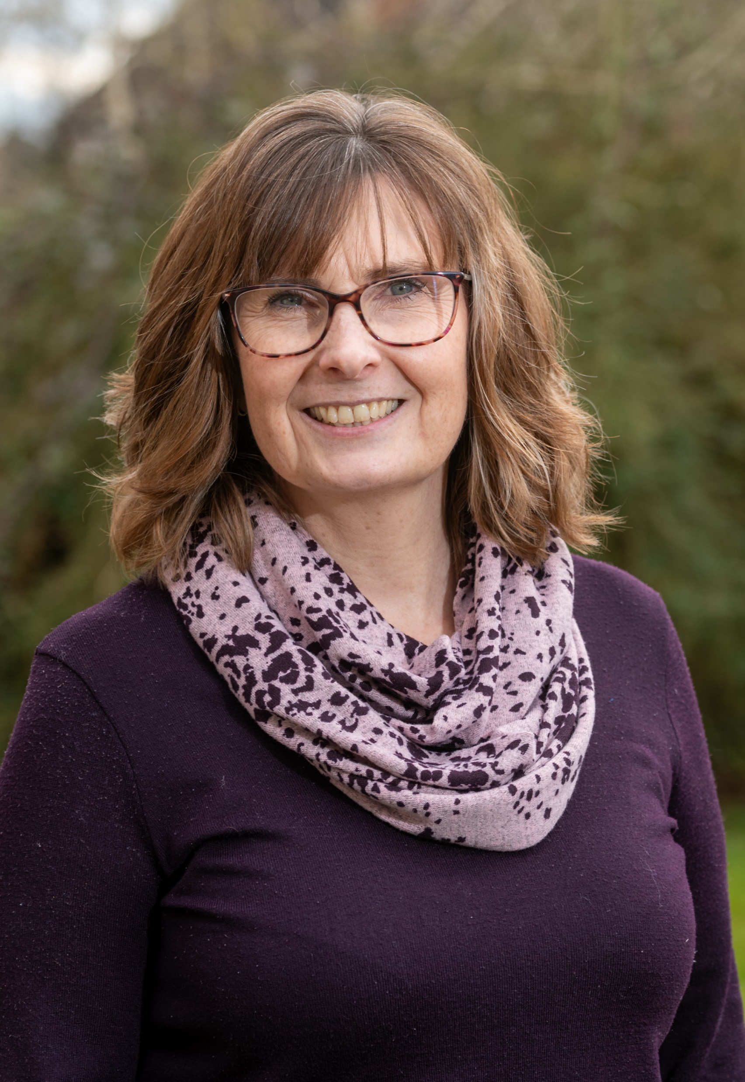
Hear from our staff
Don’t just take our word for it. Here, Lisa, our Community Development Officer, explains why you should consider working for Cambridgeshire ACRE.
What attracted you to apply for a job at Cambridgeshire ACRE?
  I was looking for a job where I could work closely with communities, Cambridgeshire ACRE has a long and trusted history of working effectively with parishes, local charities and community groups. They are well-known and respected in the voluntary sector.
What are the aspect of your job that you enjoy most?
  My work is varied and I enjoy being involved in several different projects at a time. At the root of all our work is being able to help and support communities and families which gives me a great deal of satisfaction. Community development has taught me you need to be adaptable to any situation; no two communities are alike and you need to be able to respond positively and proactively to get the very best out of people.
What opportunities have there been for you to develop your skills and experience whilst working for the organisation?
  I have been able to increase my skill level and knowledge by working across different community development projects. This has been enhanced by attending training events, as well as self-directed learning. The annual performance review process allows time to reflect and set new challenges, so you continue to grow in your role.
Why would you recommend that people apply for a job at Cambridgeshire ACRE?
Applying for a job with Cambridgeshire ACRE is a great opportunity to work for an organisation committed to rural community development enabling you to directly make a difference in people’s lives. The Charity is well respected in the voluntary sector and has a long history of supporting communities. I have found the organisation to be a very responsive employer that has supported me to grow and improve in my role.
Cambridgeshire ACRE Community Development Officer, Lisa

Slide 13
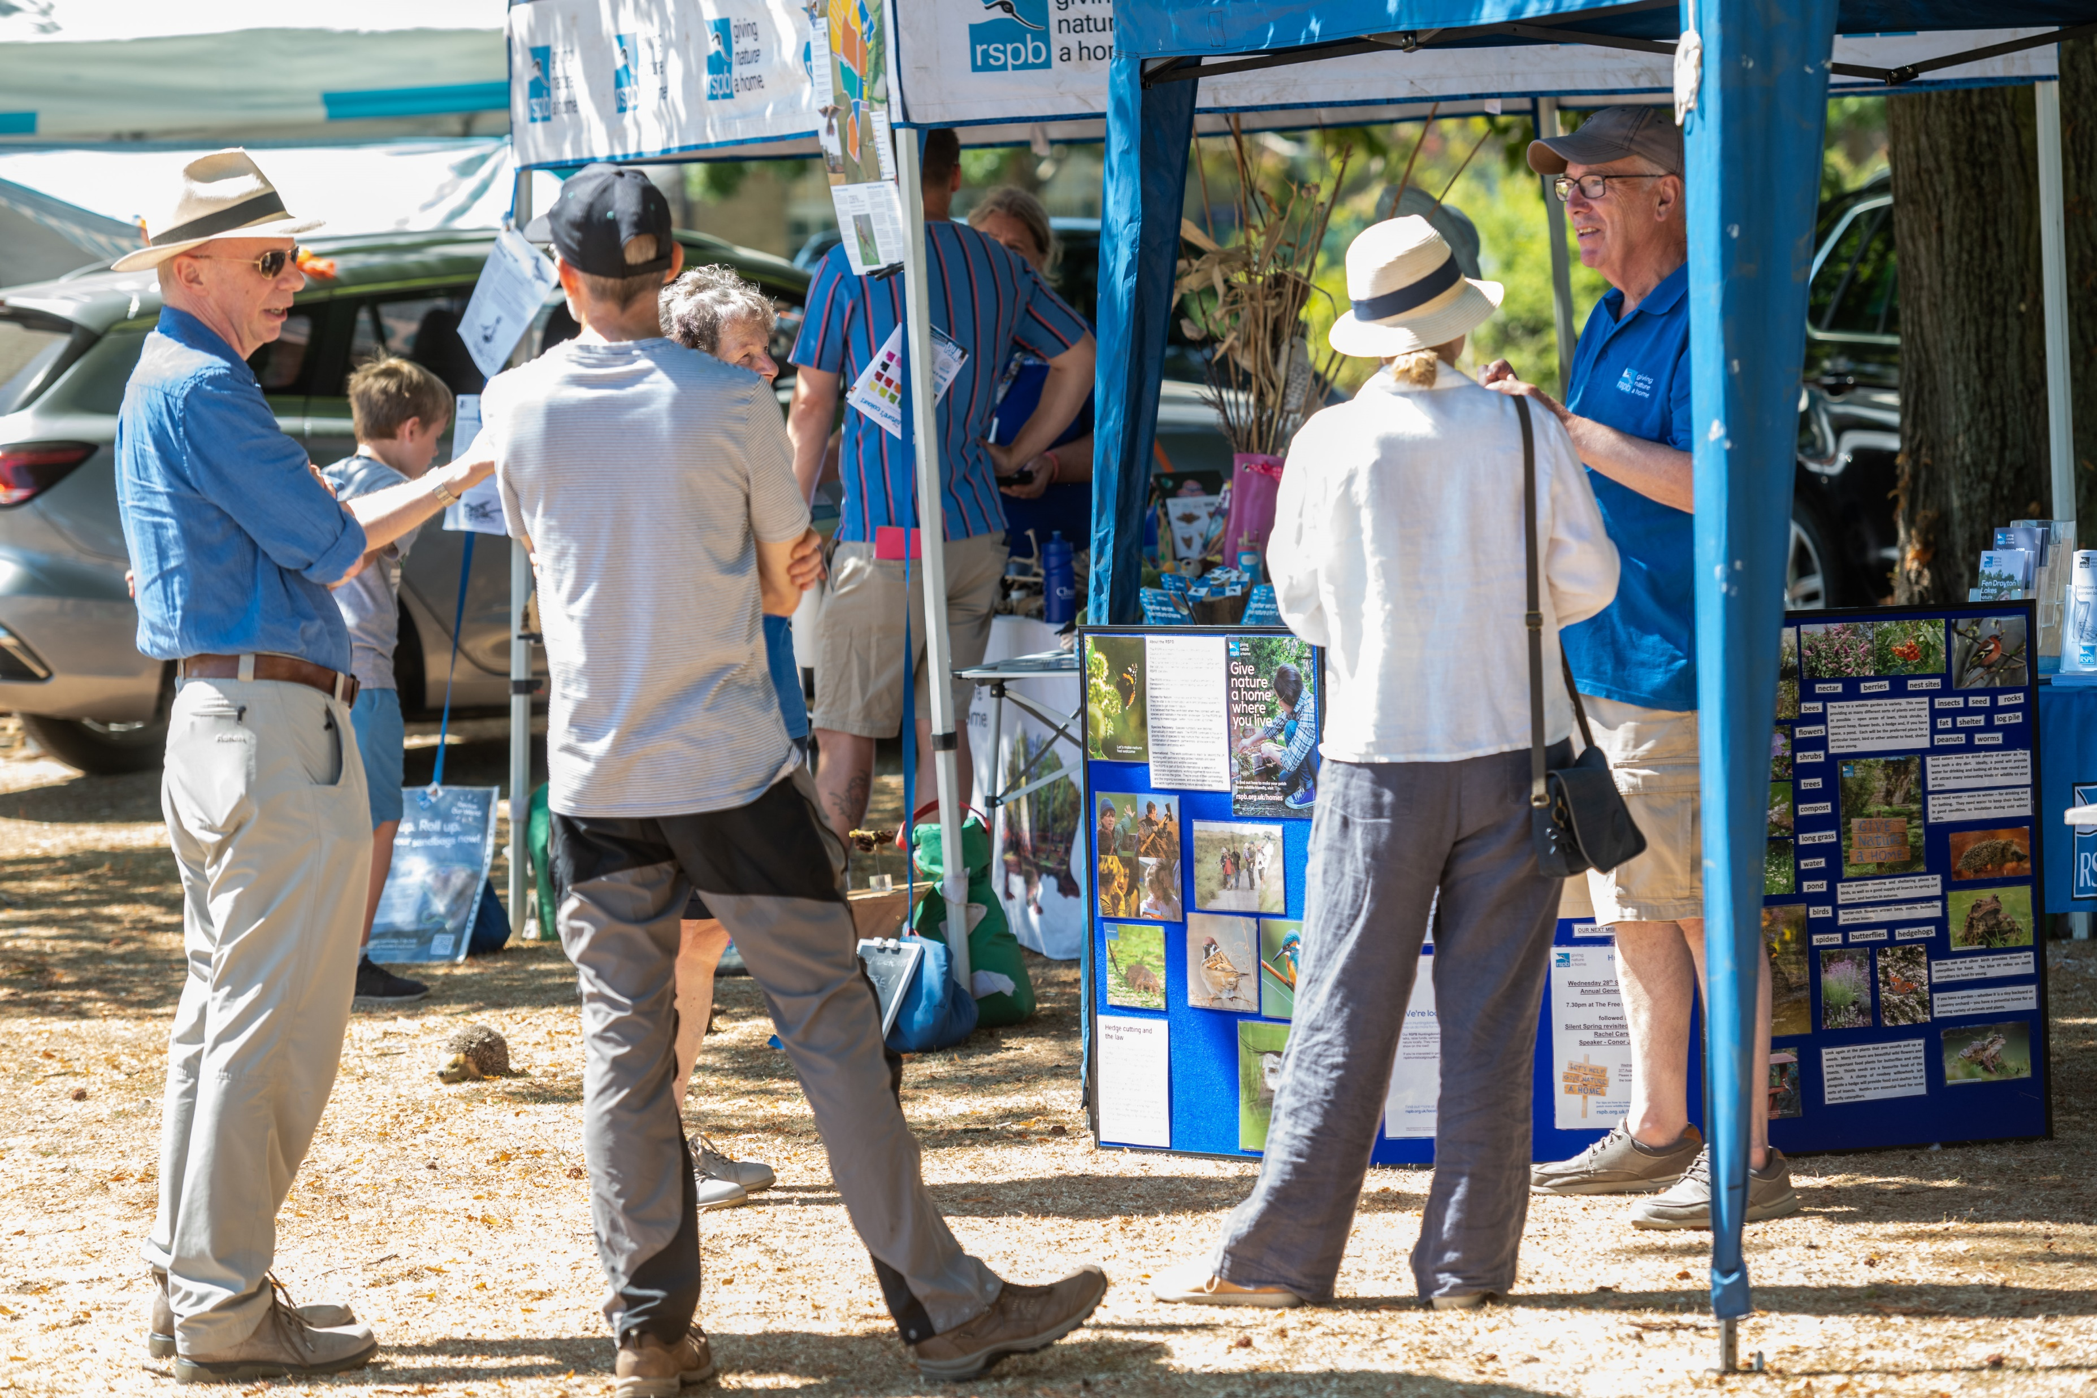
Get in touch
e-space North, 181 Wisbech Road, Littleport, Ely, CB6 1RA
01353 860850
www.cambsacre.org.uk
enquiries@cambsacre.org.uk
@cambsacre
Cambridgeshire ACRE is a Registered Charity No. 1074032 and a Company Limited by Guarantee No. 03690881
Attendees at one of our Open for Nature events
HRH The Duke of Gloucester speaking with former Chairperson, Annie Blair, at our Centenary Celebration event

